Slide 1
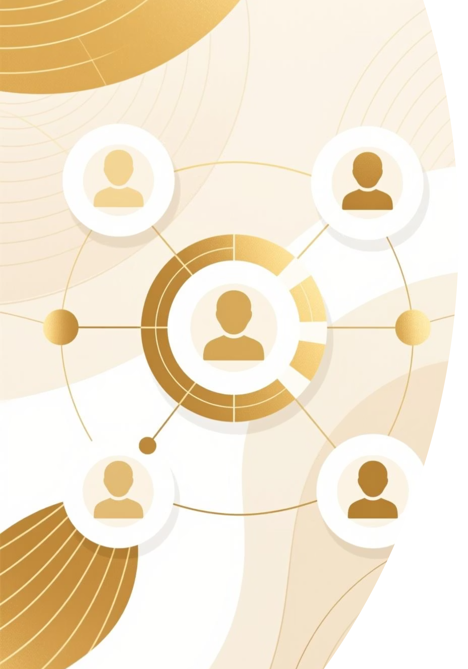
Customer Segmentation Analysis
Unlocking growth through data-driven customer insights

Slide 2

Four Distinct Customer Segments
Clustering analysis reveals clear patterns in demographics and behavior
Budget-Conscious
Low-moderate income, value-driven shoppers
Young Explorers
Younger, digitally engaged, varying spend
High-Value Loyalists
High income, high spend, long tenure
New or Inactive
Short tenure, inconsistent engagement

Slide 3





Key Metrics Driving Segmentation
Age
Annual Income
Spending Score
Generational differences in preferences and spending habits
Purchasing capacity and financial stability indicators
Customer engagement and expenditure behavior levels
Tenure
Customer Lifetime Value
Duration of customer relationship with business
Expected total revenue over customer lifecycle

Slide 4
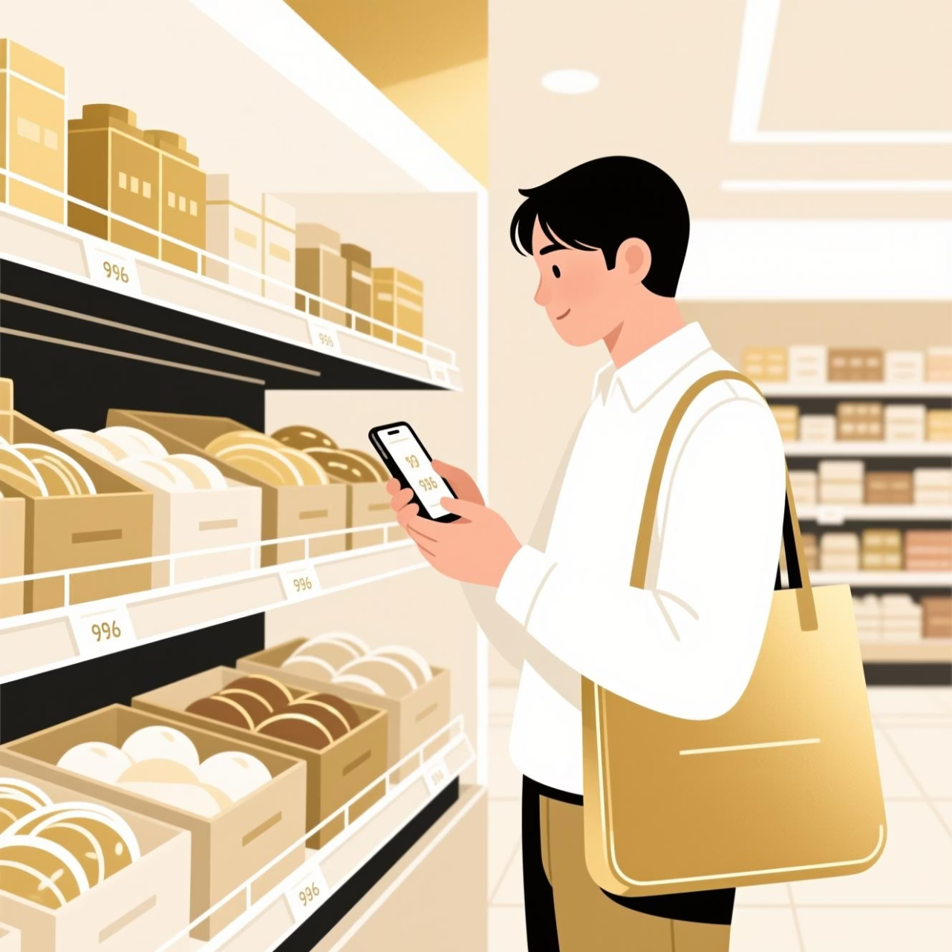
Budget-Conscious Customers
Cluster 0
Profile: Low-moderate income, moderate spending, highly price-sensitive
Why it matters: Driven by value-for-money offers and discounts
Strategy: Time-bound discounts and referral campaigns to drive repeat
purchases

Slide 5

Young Explorers
Profile
Behavior
Younger individuals, moderate income, varying spending levels
Highly responsive to digital engagement and experiential marketing
Recommendation
Influencer marketing, loyalty programs, gamified rewards

Slide 6

High-Value Loyalists
The most profitable segment with strong brand loyalty
High
High
Long
Income Level
Spending Score
Tenure
Strongest purchasing power
Consistent high expenditure
Established relationship
Strategy: Offer premium benefits, early product access, and personalized rewards to sustain loyalty

Slide 7

New or Inactive Users
Cluster 3: At-Risk Segment
Challenge: Short tenure, inconsistent spending, higher churn risk
Opportunity: Limited brand engagement means room for growth
Deploy onboarding communications
Welcome offers and incentives
Retention-driven campaigns

Slide 8
Strategic Recommendations
01
02
03
Personalize Marketing
Regular Model Updates
Predictive Modeling
Tailor campaigns to segment-specific preferences and behaviors
Refresh segmentation to reflect evolving customer data
Anticipate churn and identify high-value leads proactively
04
05
Integrate Feedback
Measure ROI
Add satisfaction data for richer segmentation insights
Track campaign performance within each segment

Slide 9








Key Takeaways
Four Clear Segments
High-Value Focus
Distinct customer groups with unique needs and behaviors identified
Loyalists drive revenue; nurture with premium experiences
Growth Potential
Data-Driven Strategy
Budget-conscious and new users offer expansion opportunities
Segmentation enables targeted marketing and improved ROI

